Slide 1
CSE101-Lec#24
Structures in functions

Slide 2
Outline
Passing structure to a function
Pointers to the structure.

Slide 3
Structure and Function
The relationship of structure with the function can be viewed from three angles:-
      Passing Structures to a function.
      Function Returning Structure.
      Passing array of Structures to Function.
Passing multiple arguments in and out of functions through a single argument
Notes:
Structure can be passed to functions as arguments both by value and by reference

Slide 4
Passing Structures to Functions
It can be done in below 3 ways:
Passing structure to a function by value
Passing structure to a function by address(reference)
No need to pass a structure – Declare structure variable as global

Slide 5
Passing of structure to a function by value
#include <stdio.h>
struct car{
char name[50];
int seats;
float price;
};
void cardata(struct car); /*function prototype*/
void main()
{
struct car myCar = {“Racer”, 1, 1200000};
cardata(myCar); //function calling
}
void cardata(struct car newCar)
{
printf(“\nData about your car is: %s %d %f”, newCar.name, newCar.seats, newCar.price);
}
Data about your car is Racer 1 1200000

Slide 6
Passing of structure member to a function by value.
#include <stdio.h>
struct car{
char name[50];
int seats;
float price;
};
void cardata(int); /*function prototype*/
void main()
{
struct car myCar = {“Racer”, 1, 1200000};
cardata(myCar.seats); //function calling
printf(“\nData about your car is: %s %d %f”, myCar.name, myCar.seats, myCar.price);
}
void cardata(int)
{
newCar.seats = 2; /*changing the number of seats*/
}
Data about your car is Racer 1 1200000

Slide 7
Passing of structure by reference to a function
#include <stdio.h>
struct car{
char name[50];
int seats;
float price;
};
void cardata(struct car*); /*function prototype*/
void main()
{
struct car myCar;
printf(“Enter data:\n”);
cardata(&myCar);
printf(“\nData about your car is: %s %d %f”, myCar.name, myCar.seats, myCar.price);
}
void cardata(struct car *newCar)
{
gets(newCar->name);
scanf(“%d %f”, &newCar->seats, &newCar->price);
}
Enter data: Racer 1 1200000
Data about your car is Racer 1 1200000

Slide 8
Functions returning structures
It is possible to return a structure from a function
The advantage of returning a structure from a function is where the calling function needs the changes done to the structure without modifying the original contents.

Slide 9
Program to return a structure.
#include <stdio.h>
struct car{
char name[50];
int seats;
float price;
};
struct car cardata(); /*function prototype*/
void main()
{
struct car myCar;
printf(“\nEnter data : Name seats and price ”);
myCar=cardata();
printf(“\nData about your car is %s %d %f\n”, myCar.name, myCar.seats, myCar.price);
}
struct car cardata()
{
struct car newCar;
scanf(“%s %d %f”, &newCar.name, &newCar.seats, &newCar.price);
return newCar;
}
Enter data: Racer 1 1200000
Data about your car is Racer 1 1200000

Slide 10
Array of Structures
To store data of 100 cars, we would be required to use 100 different structure variables from car1 to car100, which is definitely not very convenient. A better approach would be to use an array of structures.
struct car mycar[100];
This provides space in memory for 100 structures of the type struct car.

Slide 11
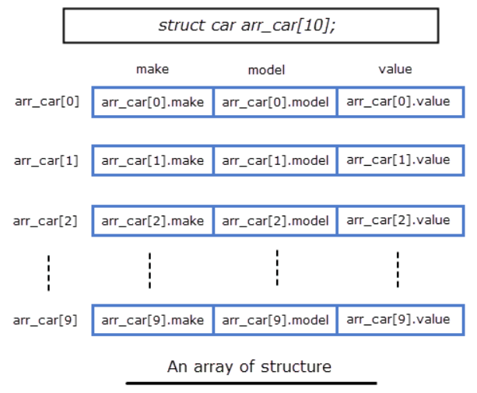
Let's take an example:
struct car
{
char make[20];
char model[30];
int year;
};
Here is how we can declare an array of structure car: .
struct car arr_car[10];

Slide 12
Program to print array of structures.
#include <stdio.h>
struct car{
char name[50];
int seats;
float price;
};
void main()
{
int i;
struct car myCar[100];
for(i=0; i<100; i++)
{
printf(“\n\nEnter data for car[%d]:\n”, i);
scanf(“%s %d %f”, &myCar[i].name, &myCar[i].seats, &myCar[i].price);
}
for(i=0; i<100; i++)
{
printf(“\nData about your car[%d] is: %s %d %f”, i, myCar[i].name, myCar[i].seats, myCar[i].price);
}
}

Slide 13
Enter data for car0: Racer 1 1200000
Data about your car0 is Racer 1 1200000
Enter data for car1: Micra 4 500000
Data about your car1 is Micra 4 500000
Enter data for car2: RacerGt 1 800000
Data about your car2 is RacerGt 1 800000
.
.
.
.
.
Enter data for car99: RacerEf 1 2000000
Data about your car99 is RacerEf 1 2000000

Slide 14
Pointers to Structure
struct car myCar, *ptr;
It declares a structures variable myCar and a pointer variable ptr to structure of type car.
ptr can be initialized with the following assignment statement
ptr = &myCar;
HOW WE CAN ACCESS THE ELEMENTS OF STRUCTURE?
But this approach will not work because dot has higher priority
Correctly way to write is:
or
*ptr.name,*ptr.seats,*ptr.age
(*ptr).name,(*ptr).seats, (*ptr).price)
ptr->name, ptr->seats, ptr->price

Slide 15
Accessing Members of Structures
Arrow operator (->) used with pointers to structure variables
    car *myCarPtr = &myCar; //intializing pointer
    printf("%s", myCarPtr->name);
  myCarPtr->name is equivalent to
    (*myCarPtr).name

Slide 16
Program for pointer to a structure
#include <stdio.h>
struct car{
char *name;
int seats;
float price;
};
int main()
{
struct car myCar = {“Renault”,2, 500000};
struct car *myCarPtr; //define a pointer to car
myCarPtr = &myCar; /*assign address of myCar to myCarPtr */
printf("%s %f %d \n%s %f %d \n%s %f %d\n",
myCar.name, myCar.price, myCar.seats,
myCarPtr->name, myCarPtr->price, myCarPtr->seats,
(*myCarPtr).name, (*myCarPtr).price, (*myCarPtr).seats);
} //end main
Renault 500000 2
Renault 500000 2
Renault 500000 2

Slide 17
Next Class: Nested Structure and Union…………

